Slide 1
BUS TOPOLOGY
Steps to Configure and Setup Bus Topology in Cisco Packet Tracer :
Step 1: First, open the cisco packet tracer desktop and select the devices given below:
Add pc(pc0,pc1,pc2,pc3)
Add switches(switch0,switch1,switch2,switch3)
IP Addressing Table
S.NO | Device | IPv4 Address | Subnet Mask
 | pc0 | 192.168.0.1 | 255.255.255.0
 | pc1 | 192.168.0.2 | 255.255.255.0
 | pc2 | 192.168.0.3 | 255.255.255.0
 | pc3 | 192.168.0.4 | 255.255.255.0
Then, create a network topology as shown below image:
Use an Automatic connecting cable to connect the devices with others.

Slide 2
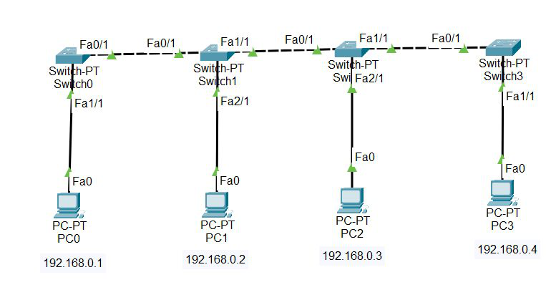
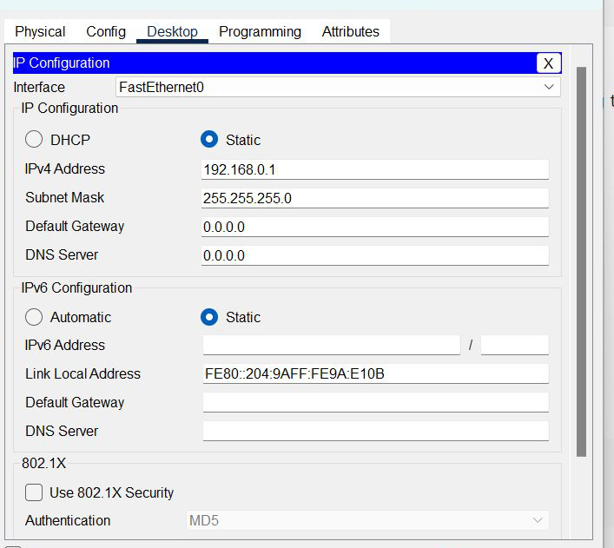
Step 2: Configure the PCs (hosts) with IPv4 address and Subnet Mask according to the IP addressing table given above.
To assign an IP address in PC0, click on PC0.
Then, go to desktop and then IP configuration and there you will IPv4 configuration.
Fill IPv4 address and subnet mask.

Slide 3
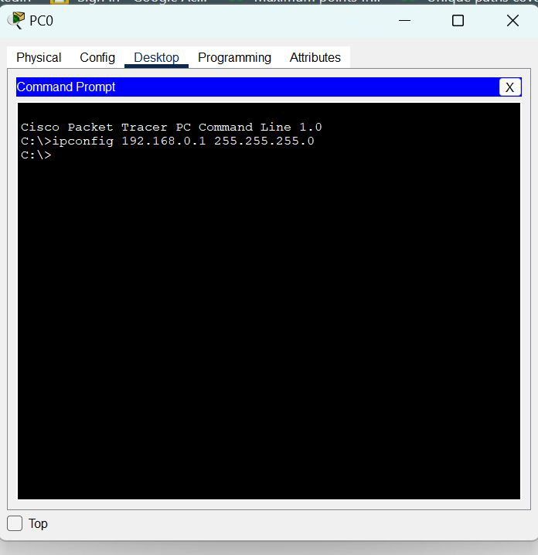
Assigning an IP address using the ipconfig command, or we can also assign an IP address with the help of a command.
Go to the command terminal of the PC.
Example: ipconfig 192.168.0.1 255.255.255.0
Then, type ipconfig <IPv4 address><subnet mask><default gateway>(if needed)
Repeat the same procedure with other PCs to configure them thoroughly.
Step 3: Verify the connection by pinging the IP address of any host in PC0.
Use the ping command to verify the connection.
As we can see we are getting replies from a targeted node on both PCs.
Hence the connection is verified.

Slide 4
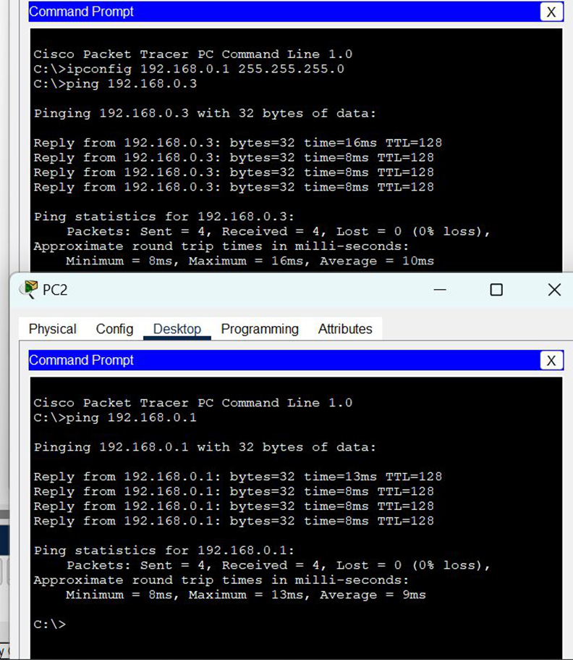
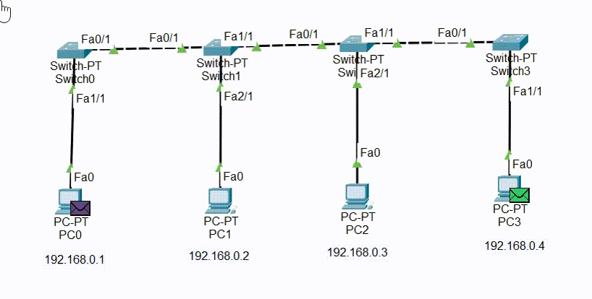
Simulation Result:

